Slide 1
Are you
Spiritually Alert
or
Spiritually
Slumbering?

Slide 3
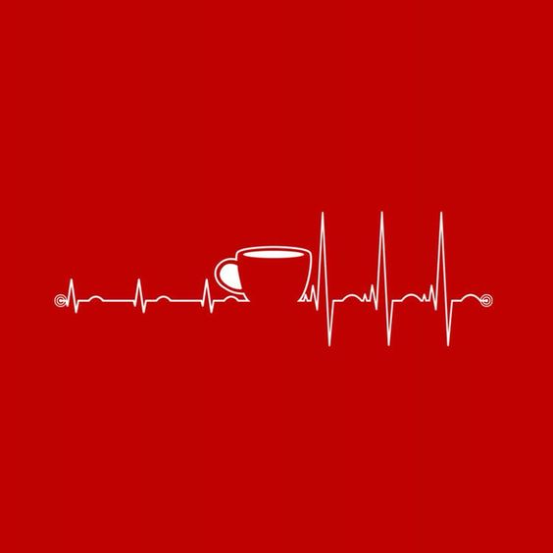

Slide 4
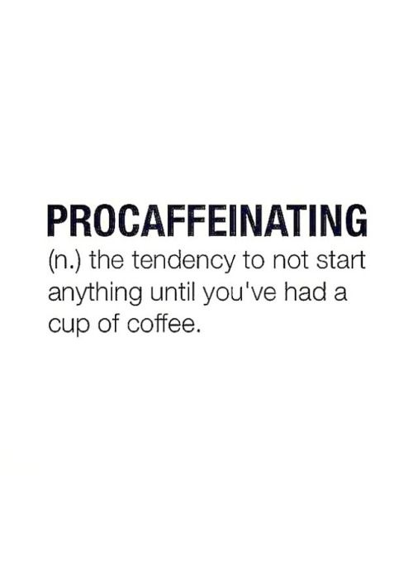

Slide 5
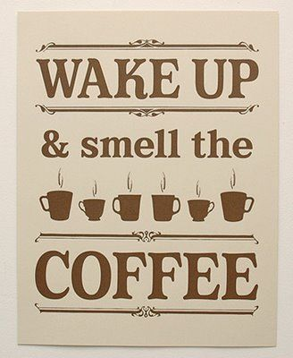

Slide 6
1 Peter 5:8
Be self-controlled and alert. Your enemy the devil prowls around like a roaring lion looking for someone to devour.

Slide 7
I Thessalonians 5:6
So then, let us not be like others, who are asleep, but let us be alert and self-controlled.

Slide 8
Three signs of those who are spiritually alert:
1. Spiritually alert people are very careful how they live.

Slide 9
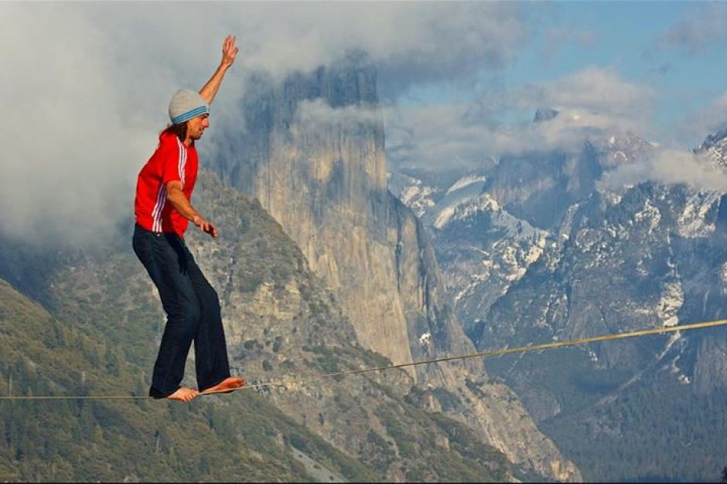

Slide 10
2. Spiritually alert people make the most of every opportunity.

Slide 12
Romans 12:1-2
Therefore, I urge you, brothers, in view of God’s mercy, to offer your bodies as living sacrifices, holy and pleasing to God—this is your spiritual act of worship.

Slide 13
3. Spiritually alert people will be filled with the Holy Spirit.

