Slide 2
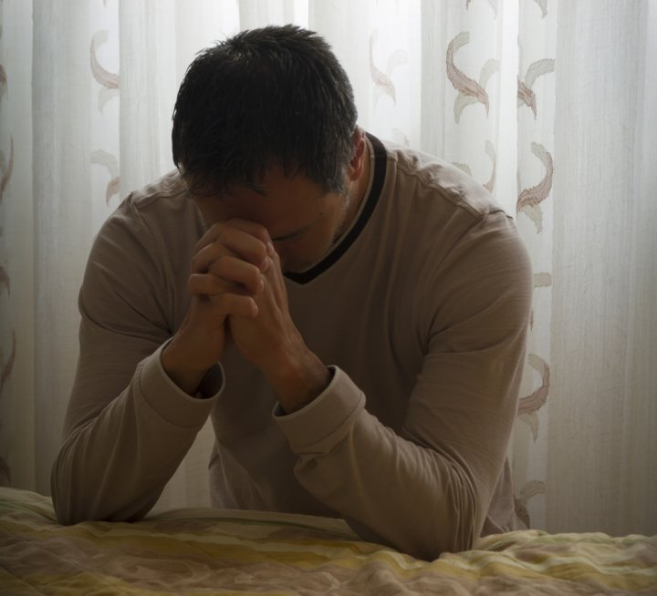
Praying Powerful Prayers for your Partners in Ministry
Philippians 1:7-11

Slide 3
What should we really be praying for concerning our partners in the gospel ministry?
1. We should pray that they would grow in love an discernment.

Slide 4
Godly love is based on godly discernment and is concerned with what is best.
Godly love is based on wisdom and is able to discern what is best.

Slide 5
2. We should pray that they would live pure and blameless lives.

Slide 6
3. We should pray that they would be filled with the fruit of righteousness.

Slide 7
4. We should pray that their lives would bring praise and glory to God.

