Slide 1
The One Thing We Must Do!
Philippians 1:27-30

Slide 3
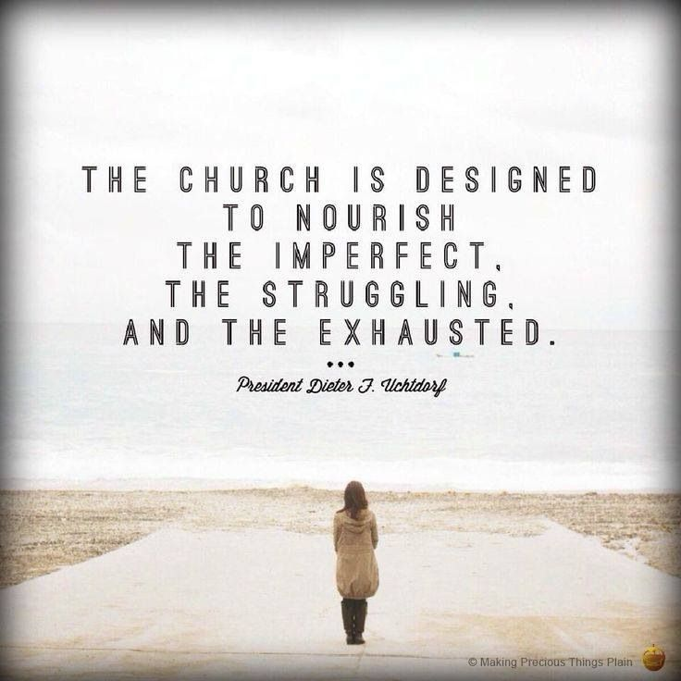

Slide 4
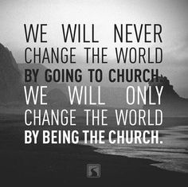

Slide 5
What does it mean for a church to conduct itself in a manner that is worthy of the gospel?
1. We are called to Stand without division.

Slide 6
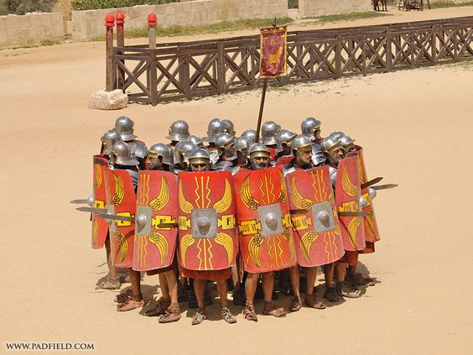

Slide 7
What does it mean for a church to conduct itself in a manner that is worthy of the gospel?
1. We are called to Stand without division.

Slide 8
2. We are called to Strive without compromise.

Slide 9
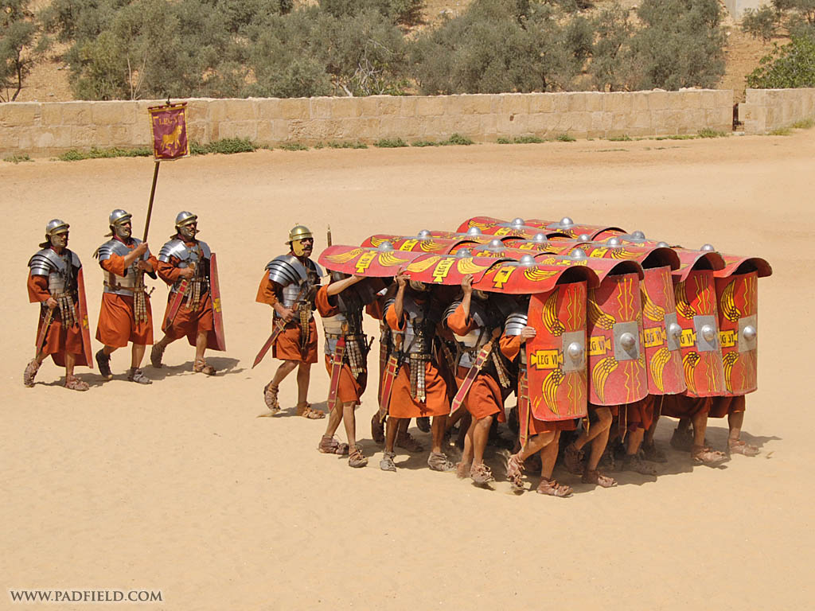

Slide 10
2. We are called to Strive without compromise.

Slide 11
3. We are called to Speak without fear.

Slide 12
4. We are called to Sacrifice without shame.

