Slide 1
Lessons we can learn from Christ’s Exaltation
Philippians 2:5-11

Slide 2
James 4:6b
“God opposes the proud but gives grace to the humble.”
James 4:10
Humble yourselves before the Lord, and he will lift you up.

Slide 3
1 Peter 5:5-6
Young men, in the same way be submissive to those who are older. All of you, clothe yourselves with humility toward one another, because, “God opposes the proud but gives grace to the humble.” Humble yourselves, therefore, under God’s mighty hand, that he may lift you up in due time.

Slide 5
Romans 10:9-10
That if you confess with your mouth, “Jesus is Lord,” and believe in your heart that God raised him from the dead, you will be saved. For it is with your heart that you believe and are justified, and it is with your mouth that you confess and are saved.

Slide 6
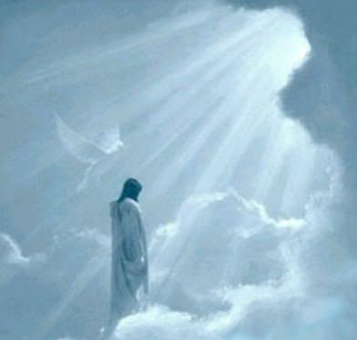
Matthew 7:21-23
“Not everyone who says to me, ‘Lord, Lord,’ will enter the kingdom of heaven, but only he who does the will of my Father who is in heaven. Many will say to me on that day, ‘Lord, Lord, did we not prophesy in your name, and in your name drive out demons and perform many miracles?’ Then I will tell them plainly, ‘I never know you. Away from me, you evildoers!’

